Slide 1
Django

Slide 2
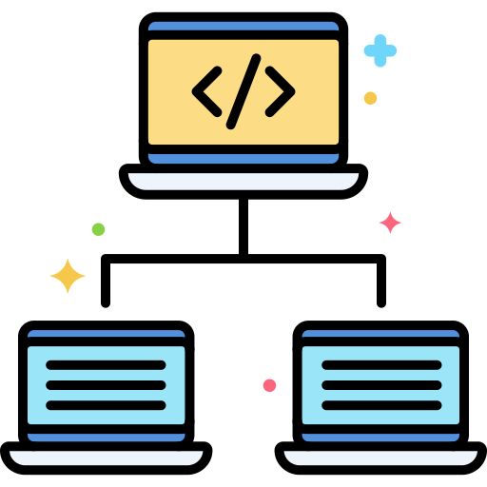
What is framework?????
Frameworks provide a set of tools and elements that help in the speedy development process. It acts like a template that can be used and even modified to meet the project requirements.
With the help of framework, you can avoid writing everything from scratch
Frameworks are based on programming languages.
Some popular frameworks are Django , Spring Boot, Angular

Slide 3

Django
Django is a high-level Python web framework that encourages rapid development and clean
Features of Python
Ridiculously fast.
Secure
Scalable

Slide 4
Install Virtual Environment
To create virtual environment
Command to create virtual environment:
virtualenv environment_name

Slide 5
How to activate a virtual Environment
Env_name\scripts\activate
How to deactivate a virtual Environment
Env_name\scripts\deactivate

Slide 6
Creating Project in Django
To run project

Slide 7
Creating app in Django

Slide 8
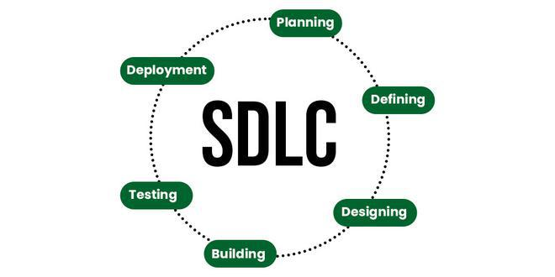
Software Development Life Cycle

Slide 9
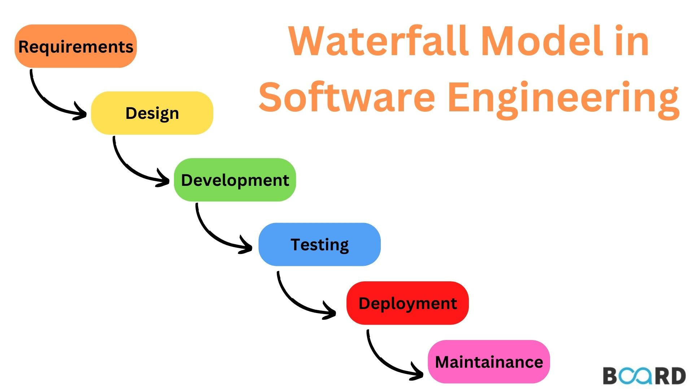
Waterfall Model

Slide 10
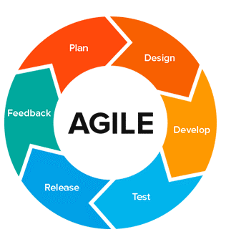
Agile Methodology

Slide 11
What is Scrum???
A better way for building products

Slide 12
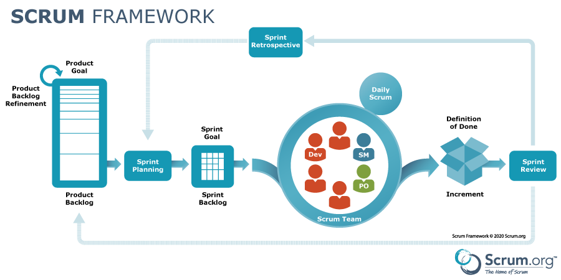

Slide 13
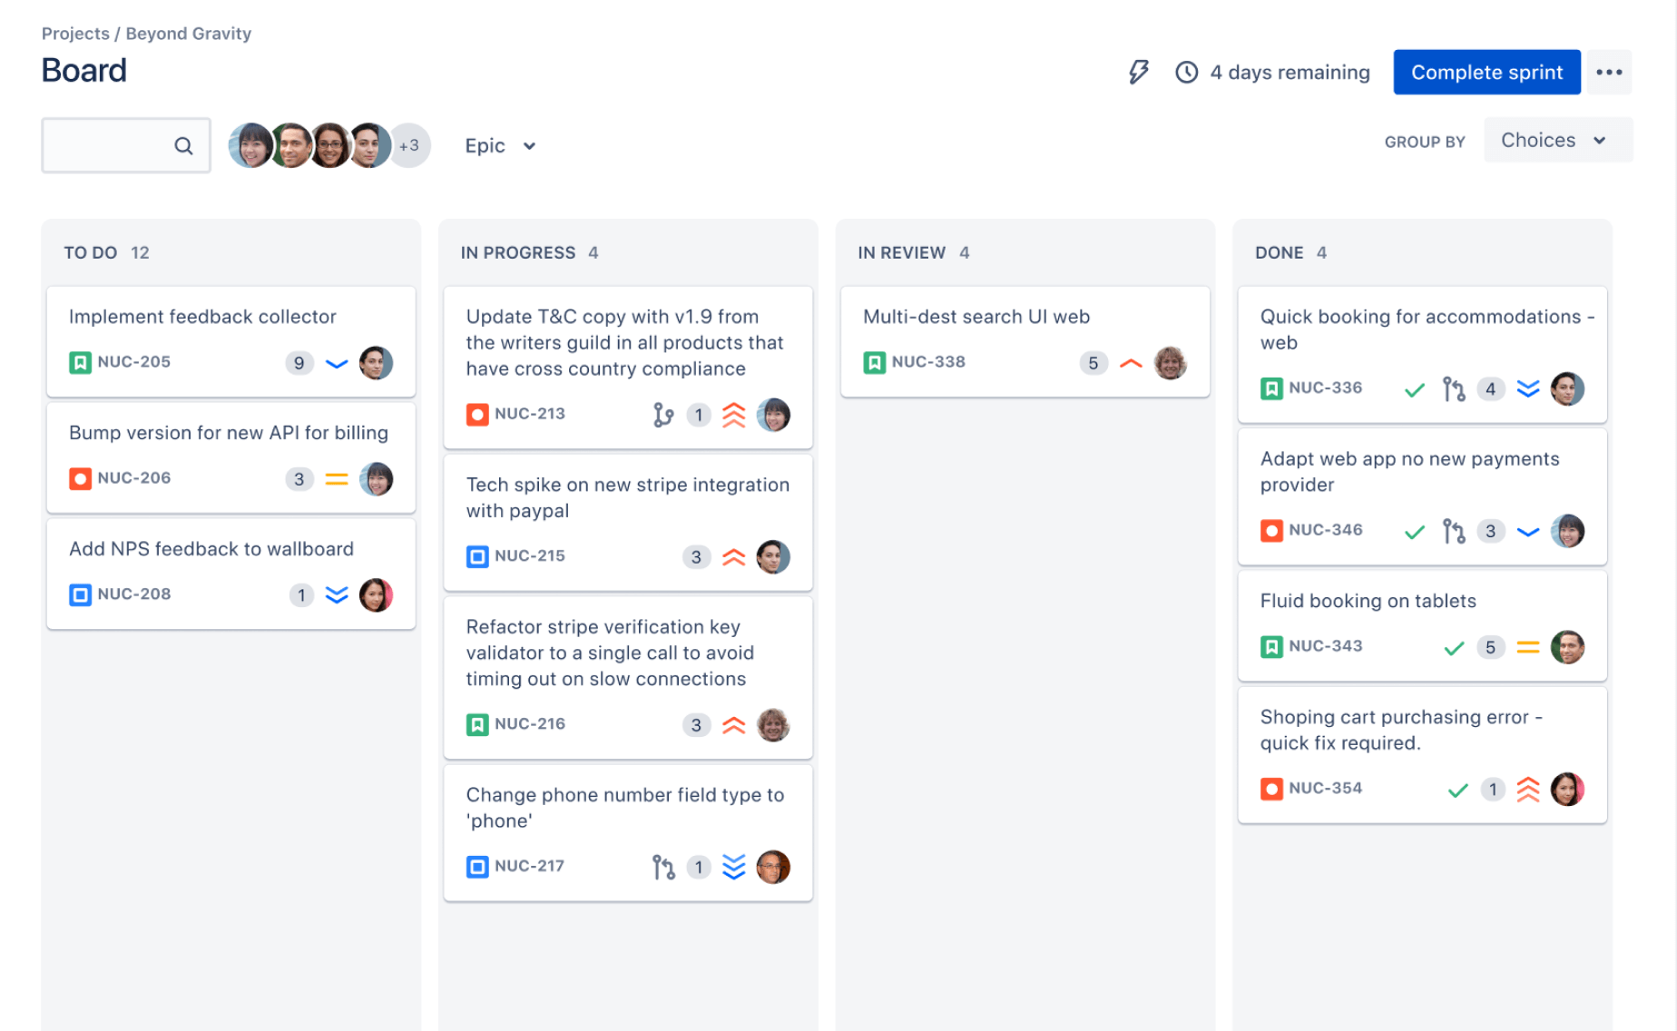

Slide 14
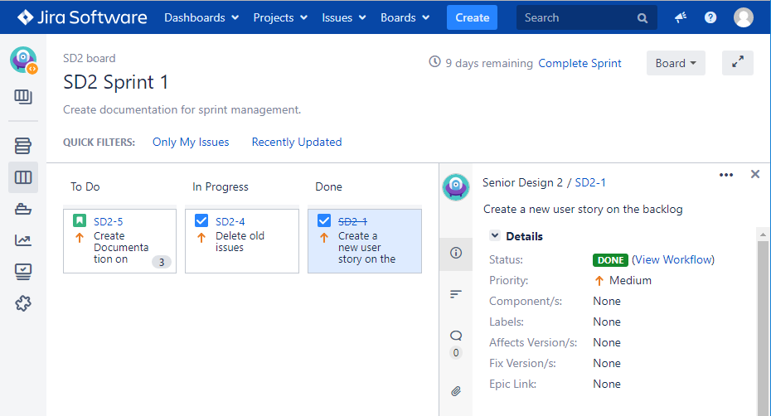

Slide 15
